Slide 1
Application talk How I use #@ Script parameters for declaring inputs in ImageJ macros
Øyvind Ødegård Fougner

Slide 2



ImageJ macros are ideal for quick prototyping
Exploratory phase
Find correct imaging settings
Proof of
principle
Intermediate number of images
Computer assisted manual image analysis
Data acquisition
Large image datasets
Automated image analysis
Identify which features to extract

Slide 3
How I organize my code?
One macro to do it all
Main macro calls specialized macros
For each image:
Gaussian blurring
Manual user input
Saving annotations
Simple to write
Simple to distribute
Difficult to troubleshoot
Specific to one task
For each image:
Call pre-processing macro
Call segmentation macro
Call quantification macro
Save results
Each macro has its clear purpose
No copying of code from macro to macro
Can become “too” complicated
Macros need to communicate
✓
✓
X
X

Slide 4
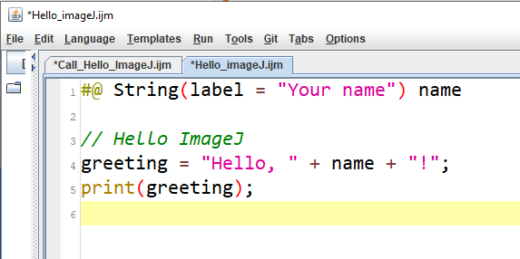
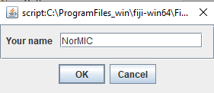
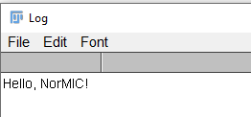
Using #@ Script parameters to communicate with the user, and with other macros
A simple way to define input variables in ImageJ
A simple way to make a graphical user interphase
Hello ImageJ example
Input dialogue
Output print
https://github.com/oodegard/imageJ_ScriptParameters
https://imagej.net/Script_parameters

Slide 5
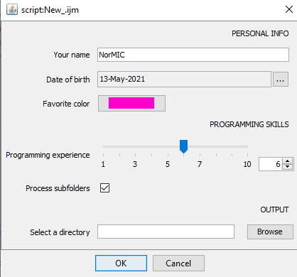
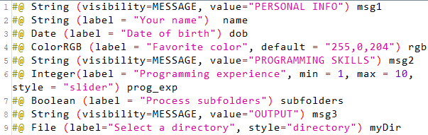
Users can input a variety of different object types
RUN
https://github.com/oodegard/imageJ_ScriptParameters
https://imagej.net/Script_parameters

Slide 6
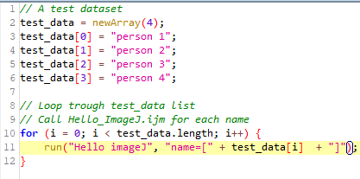
You can call other macros from a macro
Run
The “Hello imageJ” macro can then be called from any macro you write.
Your main program loop becomes less complicated.
If you find a mistake in your “Hello imageJ” macro you only need to edit it one place.
Output
Hello, person 1!
Hello, person 2!
Hello, person 3!
Hello, person 4!
https://github.com/oodegard/imageJ_ScriptParameters
https://imagej.net/Script_parameters

Slide 7
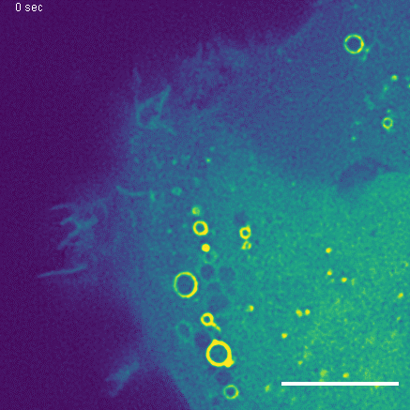
Macropinocytosis – The cells way of drinking and sampling the environment
Cell membrane ruffles
Encapsulation of extracellular liquid and cargo
Vesicle formation
Diameter: 0.2 – 5µm
Intracellular translocation
Scale 10 µm

Slide 8
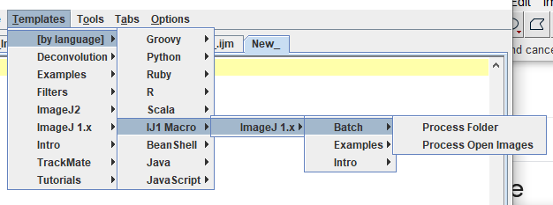
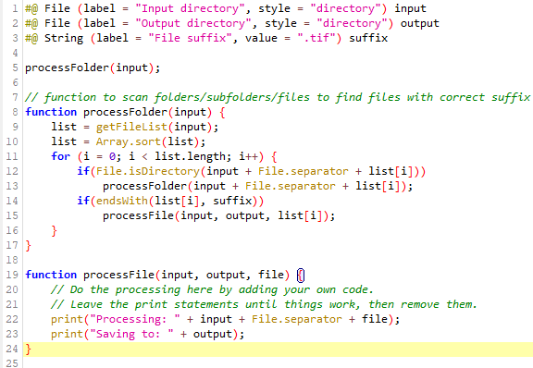
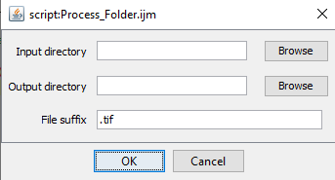
ImageJ macro template to process all files in a folder
RUN
https://github.com/oodegard/imageJ_ScriptParameters

Slide 9
Manual multipoint annotation macro
Loop over all images in a folder
Pre-processing
Ask user to annotate tracks
Python:
Save user annotation
https://github.com/oodegard/imageJ_ScriptParameters

